Slide 1


How does ChatGPT work?

Slide 2
A review of the structure of the webinar series

Slide 3
ChatGPT
GPT: generative pre-trained transformer

Slide 4
ChatGPT
Transformer
a multi-layer neural network that relies on the parallel multi-head attention mechanism.

Slide 5
ChatGPT
Part 1: multi-layer neural network
Part 2: multi-head attention mechanism

Slide 6
Last time
Part 1: multi-layer neural network

Slide 7

Last time
neuron
One neuron
One layer
input
output

Slide 8

Last time
output
many neurons
one layer
input
output
output

Slide 9
Today
Part 1: multi-layer neural network
CONTINUED

Slide 10
Many neurons, many layers

Slide 11
output
output
many neurons
many layers
input
output
output

Slide 12
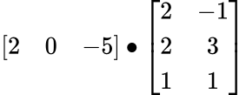
Exercise

Slide 13
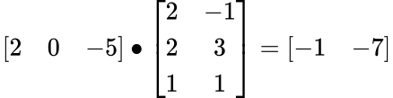
Answer

Slide 14
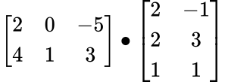
Exercise

Slide 15
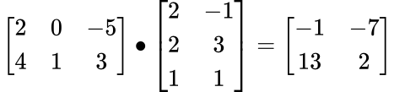
Answer

Slide 16
Any questions?

Slide 17
Many neurons, many layers

Slide 18
output
output
many neurons
many layers
input
output
output

Slide 19
The task of ChatGPT
Given a sequence of words, what is the most likely word that appears next?

Slide 20
In the house classification example, we use a feature vector to represent a house and use it to predict the house being good or bad
By analogy, we will need to use feature vectors of words to predict the next possible word in a sequence.
How do we derive the feature vectors of words?

Slide 21
We’ll introduce a model that derives feature vectors of words called skip-gram, a neural network that looks like …

Slide 22
Skip gram
output layer
o_{n1}
output
hidden layer
h_{n1}
o_{n2}
output
many neurons
many layers
input
h_{n2}
o_{n3}
output
h_{n3}
o_{n4}
output
… …
… …

Slide 23



Recall that…
w^{c1}, b^{c1}
Softmax
n1
P₁
w^{c2}, b^{c2}
n2
x
P₂
sum up to 1
w^{c3}, b^{c3}
n3
P₃
Each neuron has its own weight vector and bias term

Slide 24



Generalizing
g
f
o_{n1}
P₁
h_{n1}
o_{n2}
P₂
h_{n2}
x
sum up
to 1
o_{n3}
P₃
h_{n3}
o_{n4}
… …
P₄
… …
… …

Slide 25
Skip-gram is much simpler!

Slide 26
Skip gram
No bias term in either the hidden layer or the output layer
No activation function in the hidden layer

Slide 27
Skip gram
Softmax
o_{n1}
P₁
h_{n1}
o_{n2}
P₂
h_{n2}
x
sum up to 1
o_{n3}
P₃
h_{n3}
o_{n4}
… …
P₄
… …

Slide 28
word2vec
Back to the task of deriving feature vectors of words

Slide 29
How to derive word vectors?
The distributional hypothesis: words that have similar context will have similar meanings
We’ll derive the vector representations of words from their context words!

Slide 30
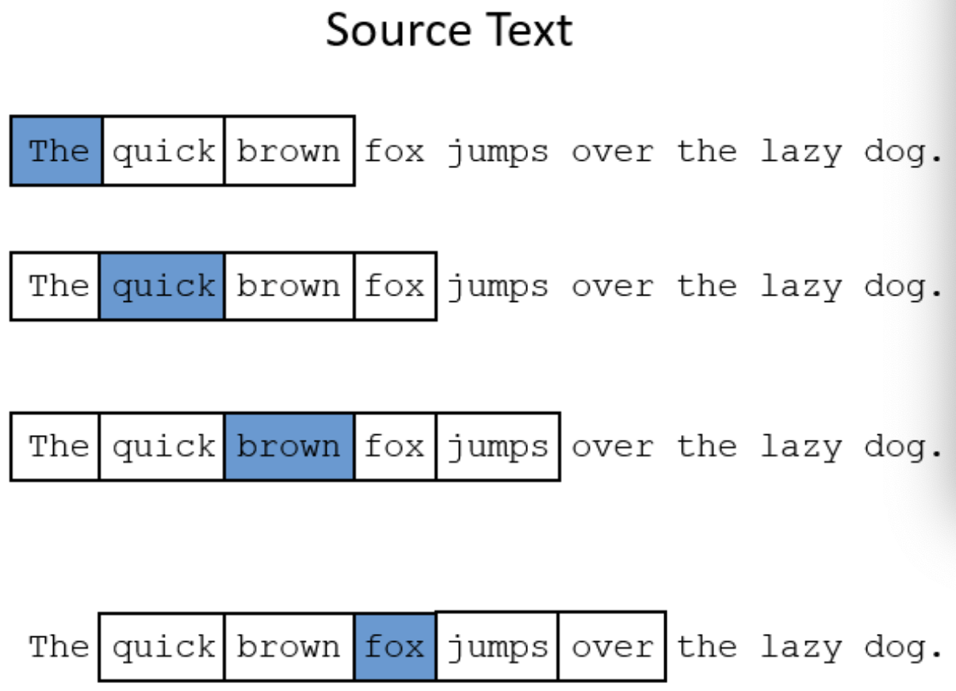
What is the context of a word?
context window size = 2

Slide 31
(Fake) task of skip gram
o_{n1}
word₁
h_{n1}
o_{n2}
word₂
Input word
h_{n2}
o_{n3}
word₃
h_{n3}
o_{n4}
… …
word₄
… …
… …

Slide 32
Real task of skip gram
o_{n1}
word₁
h_{n1}
o_{n2}
word₂
Learn the weights of the hidden layer, and use these weights as the vector representations of the input words
Input word
h_{n2}
o_{n3}
word₃
h_{n3}
o_{n4}
word₄
… …
… …
… …

Slide 33
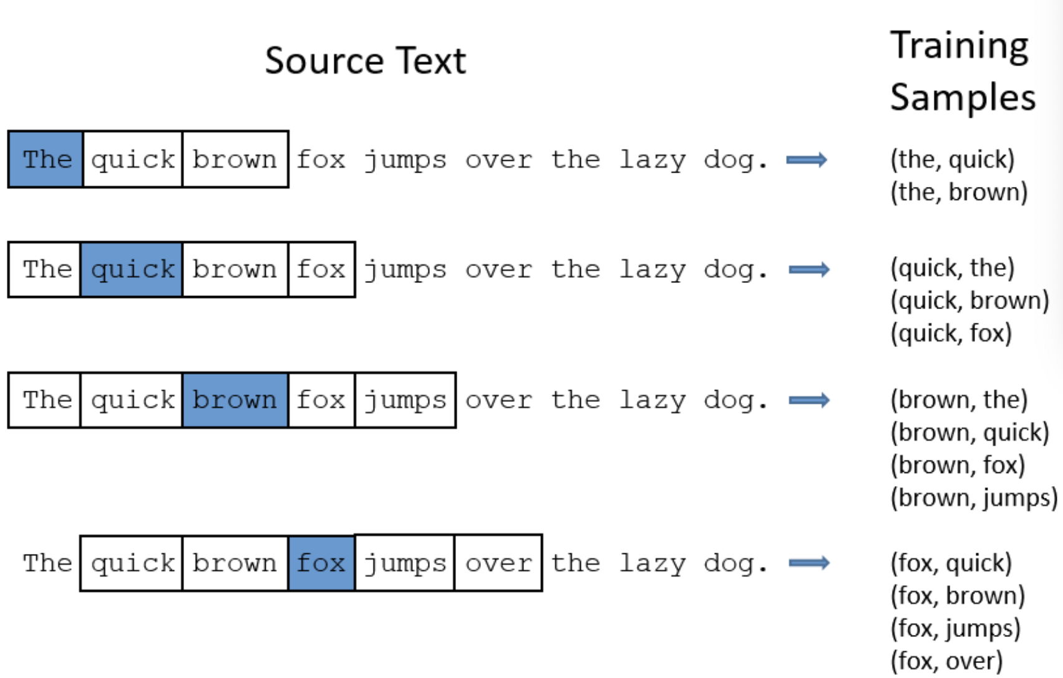
Skip gram

Slide 34
Task of skip-gram:
a classification task
Given a target word, say, ‘ants’, we train a classifier. For each word w in the vocabulary, is w likely to be a context word of ‘ants’?

Slide 35
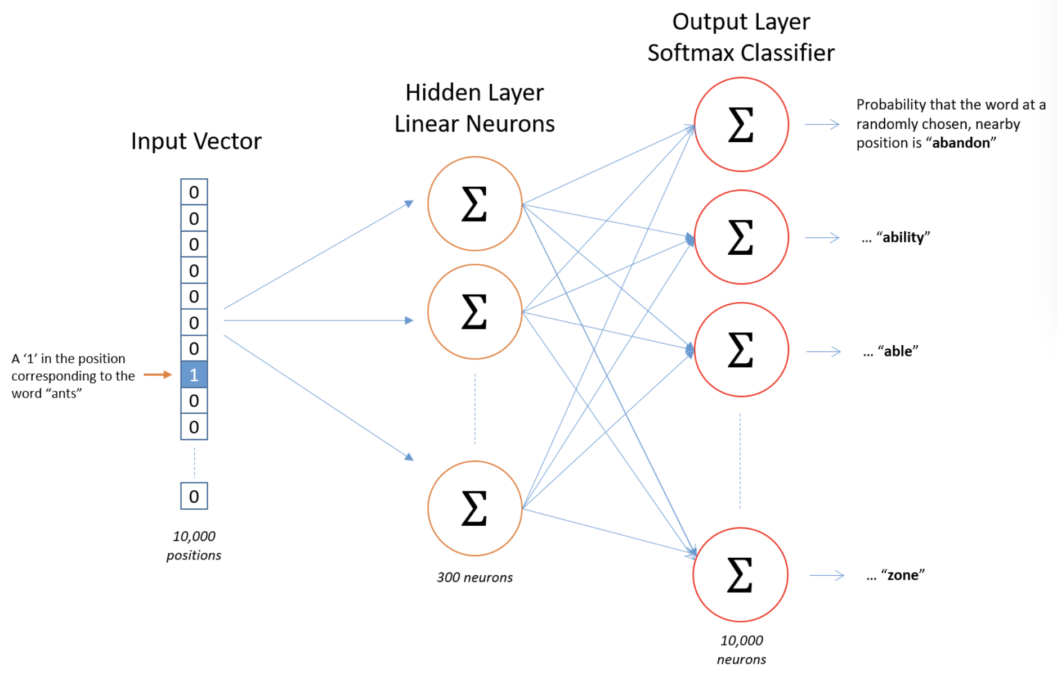
Skip-gram

Slide 36
One-hot vector
A vector with one value equal to 1 and all rest 0
For example,

Slide 37
Skip-gram
Vocab size: 10000
300 neurons in the hidden layer

Slide 38
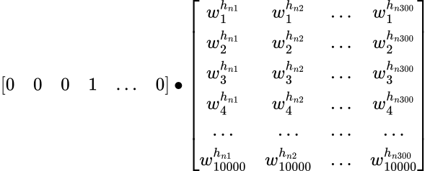
Given one input word

Slide 39
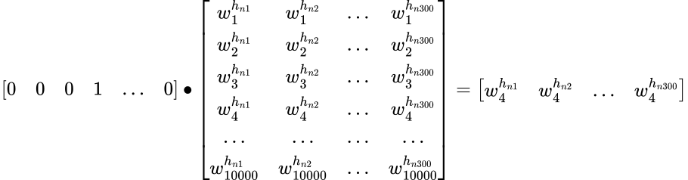
From input layer to hidden layer

Slide 40
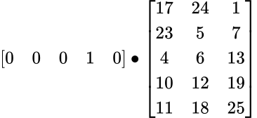
Exercise
What’s the effect of the one-hot vector?
Vocab size: 5
3 neurons in the hidden layer

Slide 41
A look-up table

Slide 42
word2vector

Slide 43
Skip-gram

Slide 44
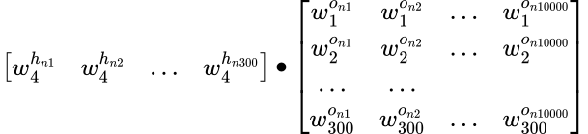
From hidden layer to output layer

Slide 45
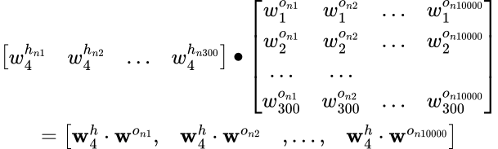
From hidden layer to output layer

Slide 46
Softmax
(activation function)
Softmax function
The softmax function takes a vector of K values [z₁, z₂, …z_{K}] , and maps the values to a probability distribution where each value is in the range (0,1) and the probabilities sum up to one.

Slide 47
Skip-gram

Slide 48
Minimize the error
For those words in the vocabulary which are the context words of the input word, we want the output probabilities for them to be high.
For those words in the vocabulary which are not the context words of the input word, we want the output probabilities for them to be low.

Slide 49
Minimize the error
When we calculate the outputs, we take in an input and go from the hidden layer to the output layer.
When we calculate the error to minimize it, we go from the output layer back to the hidden layer. This is called backward propagation of errors (backpropagation).

Slide 50
Word similarity
The distributional hypothesis:
words that have similar context will have similar meanings

Slide 51
Word similarity
If two words have very similar surrounding words, then they are very similar in meaning.
This means, the two words will have very similar output probability distribution with regard to the words in the vocabulary.
This also means, two words similar meaning will ultimately get very similar vector representations.

Slide 52
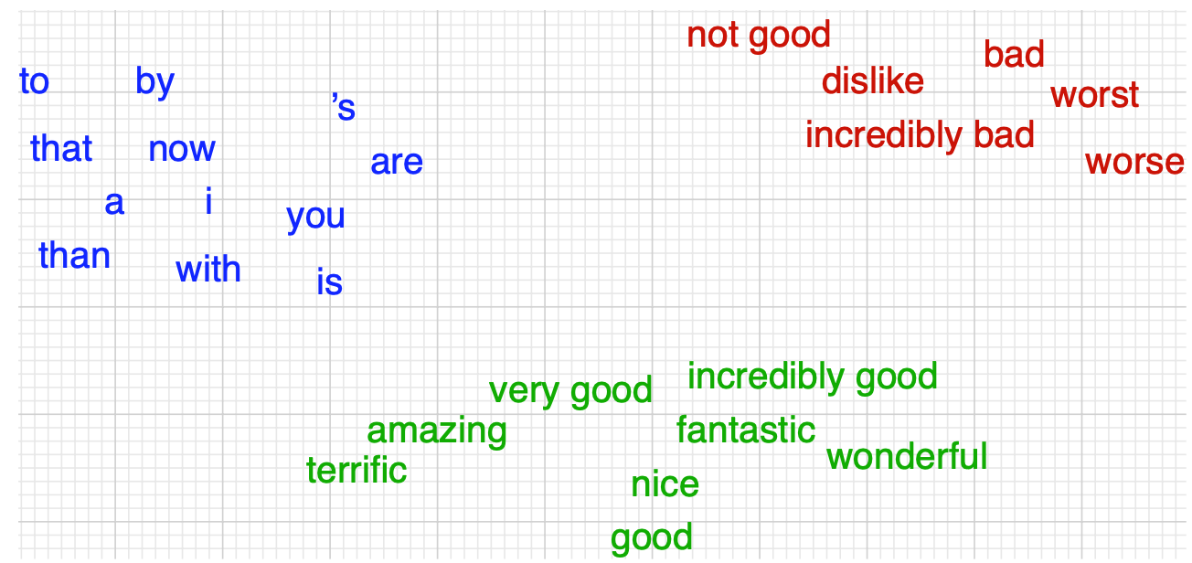
Word similarity visualized in a 2-dim space
Jurafsky, Daniel, and James H. Martin (2023)

Slide 53
Any questions?

Slide 54
Learning objectives
Concepts
Understand some basic concepts in neural networks
feature, weight, bias, vector, matrix……
neuron, activation function, hidden layer……
Understand a neuron as a computation unit
Understand the fundamental algorithms underlying NNs
Hands-on computation
Know how to do matrix multiplication by hand

Slide 55
A quick review of matrix multiplication
Softmax
w^{c1}, b^{c1}
n1
P₁
w^{c2}, b^{c2}
n2
x
P₂
sum up to 1
w^{c3}, b^{c3}
n3
P₃
… …

Slide 56
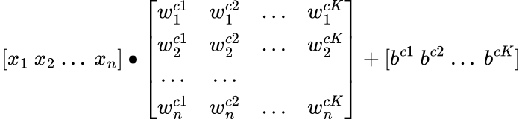
Matrix multiplication
w
b
x

Slide 57
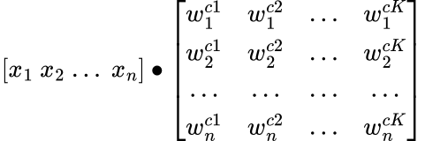
x∙w
w
x

Slide 58
x∙w
w
x

Slide 59
x∙w
w
x

Slide 60
The importance of shape
w
x

Slide 61
x∙w
w
w^{c1}
w^{c2}
w^{cK}
x
x⦁w^{c1}
x⦁w^{cK}

Slide 62
x∙w
w
w^{c1}
w^{c2}
w^{cK}
x

Slide 63
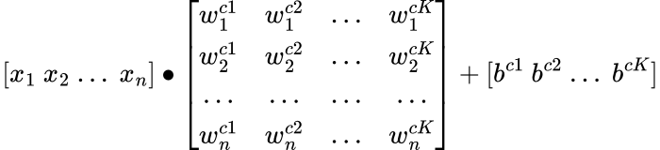
Given one observation…

Slide 64

Add the bias

Slide 65
Add the bias

Slide 66
Add the bias

Slide 67
Exercise

Slide 68
Answer

Slide 69
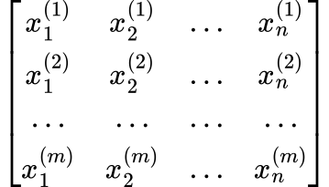
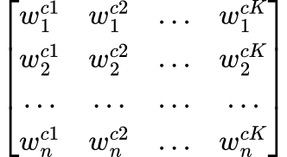

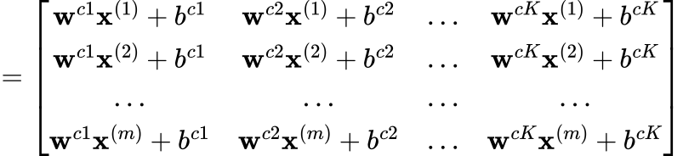
Calculate all observations at one time:
Matrix multiplication
w^{c1}
w^{c2}
w^{cK}
x⁽¹⁾
x⁽²⁾
x^{(m)}

Slide 70
Calculate all observations at one time:
Matrix multiplication
w^{c1}
w^{c2}
w^{cK}
x⁽¹⁾
x⁽²⁾
x^{(m)}

Slide 71
Calculate all observations at one time:
Matrix multiplication
w^{c1}
w^{c2}
w^{cK}
x⁽¹⁾
x⁽²⁾
x^{(m)}

Slide 72
Calculate all observations at one time:
Matrix multiplication
w^{c1}
w^{c2}
w^{cK}
x⁽¹⁾
x⁽²⁾
x^{(m)}

Slide 73
Calculate all observations at one time:
Matrix multiplication
w^{c1}
w^{c2}
w^{cK}
x⁽¹⁾
x⁽²⁾
x^{(m)}

Slide 74
Calculate all observations at one time:
Matrix multiplication
w^{c1}
w^{c2}
w^{cK}
x⁽¹⁾
x⁽²⁾
x^{(m)}

Slide 75
Exercise

Slide 76
Answer

Slide 77
References
Jiang, L. (2020). A Visual Explanation of Gradient Descent Methods (Momentum, Ada-Grad, RMSProp, Adam). June-2020. [online]. Available: https://towardsdatascience.com/a-visual-explanation-of-gradient-descent-methods-momentum-adagrad-rmsprop-adam-f898b102325c
Jurafsky, Daniel, and James H. Martin. (2023). Speech and language processing: An introduction to natural language processing, computational linguistics, and speech recognition.
McCormick, C. (2016). Word2vec tutorial-the skip-gram model. Apr-2016.[Online]. Available: http://mccormickml.com/2016/04/19/word2vec-tutorial-the-skip-gram-model.
Mikolov, T., Sutskever, I., Chen, K., Corrado, G. S., & Dean, J. (2013). Distributed representations of words and phrases and their compositionality. Advances in neural information processing systems, 26.

